Slide 1


K.RAMAKRISHNAN COLLEGE OF TECHNOLOGY
(AUTONOMOUS), TRICHY.
DEPARTMENT OF
COMPUTER SCIENCE AND ENGINEERING
20CS5501 DESIGN PROJECT-1
Date : 07.12.2024

Slide 2
PERSONAL FINANCE TRACKER
Guided by Team
Mr. R. Rajavarman,M.E.,(Ph.D)., Shrihari J (811722104147)
Assistant Professor, CSE Thishal M (811722104169)
Vishwas S (811722104187)

Slide 3
OBJECTIVE OF THE PROJECT
The primary objective of the Finance Management project is to develop an intuitive and secure web application that simplifies personal financial management. The application aims to provide users with tools to track, visualize, and manage their income, expenses, and investments efficiently. By integrating advanced technologies and professional designs, the system seeks to:
Enable users to add, view, and delete financial records easily.
Offer dual representation of financial data through a list view for detailed analysis and a chart view for insightful visualizations.
Provide a seamless user experience with professional animations and an intuitive interface.
Ensure robust data security and privacy through JWT-based authentication and reliable database management.
Empower users to make informed financial decisions by presenting organized and actionable insights.

Slide 4
ABSTRACT
Finance Management is a web-based application designed to simplify personal financial management by enabling users to track income, expenses, and investments. Built with Node.js, Express.js, and MongoDB, it ensures secure data handling with JWT authentication.
The app features an intuitive interface with professional designs and animations, offering two modes for data visualization:
List View: For detailed analysis.
Chart View: For visual insights into financial trends.
With the ability to add, view, and delete financial records, Finance Management empowers users to organize their finances efficiently. Its secure, user-friendly design bridges the gap between technology and financial management, making it an indispensable tool for modern users.

Slide 5
LITERATURE SURVEY
S.NO | JOURNAL NAME & YEAR | AUTHOR NAME | TITLE | METHODOLOGY | MERITS | DEMERITS
1 | International Journal of Financial Studies, 2018 | J. Smith, M. Brown | Design of Personal Finance Tracker Applications | Utilizes machine learning algorithms to predict expenses and optimize savings based on user behavior. | Provides personalized insights and recommendations for better financial management. | Requires access to sensitive personal data, raising privacy concerns.
2 | Journal of Personal Finance and Economics, 2020 | A. Lee, K. Williams | Mobile Applications for Personal Budget Management | A comparative study of various mobile apps using data visualization techniques to improve user engagement. | Increases user engagement and understanding through intuitive visual dashboards and notifications. | Dependency on user input accuracy; may not account for unplanned expenses or cash transactions.

Slide 6
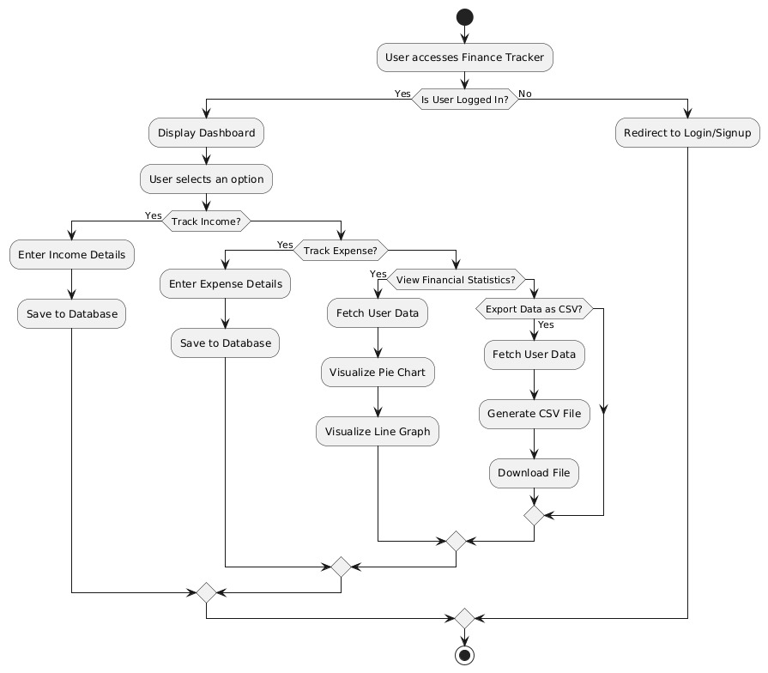
PROPOSED SYSTEM ARCHITECTURE

Slide 7
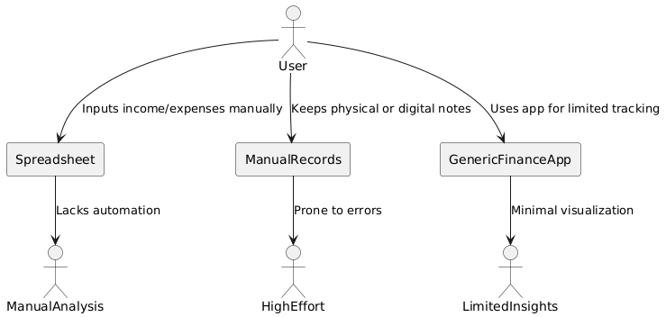
EXISTING SYSTEM ARCHITECTURE

Slide 8
SOFTWARE AND HARDWARE REQUIREMENTS
HARDWARE
SOFTWARE
Processor : Intel i3 or Higher
RAM : 4GB or Higher
Storage : 150GB or Higher
HTML
CSS
JS
Tool: Vs Code

Slide 9
MODULES
User Authentication Module
Transaction Management Module
Financial Analysis Module
Reporting Module

Slide 10
SUMMARY OF MODULE-1
USER AUTHENTICATION MODULE
The User Authentication Module is the first line of defense in ensuring secure access to the Finance Management System (FMS). It facilitates the login and logout processes by requiring users to enter their credentials, such as a username and password. For added security, the system includes Two-Factor Authentication (2FA), which requests a second form of authentication, such as a one-time password (OTP) sent to the user’s mobile or email. Additionally, biometric authentication options, such as fingerprint or facial recognition, can be integrated for quick and secure access. To further enhance security, the module incorporates role-based access control to ensure that different users have appropriate permissions based on their roles, such as administrators or regular users. The module also features a password recovery mechanism in case users forget their credentials, guiding them through a secure process to regain access to their accounts.

Slide 11
SUMMARY OF MODULE-2
TRANSACTION MANAGEMENT MODULE
The Transaction Management Module plays a crucial role in recording, categorizing, and tracking all financial transactions within the FMS. Users can input details of their transactions, such as the amount, category (e.g., groceries, bills), date, and payment method (e.g., cash, credit card). The system also supports recurring transactions, allowing users to automate entries for regular expenses, such as monthly rent or salary payments. Transaction categorization helps users organize their spending, making it easier to track how much is spent in various areas like utilities, entertainment, and savings. This module also maintains a detailed transaction history, which users can review to analyze spending habits. For those who engage in international transactions, the module supports multi-currency transactions, automatically converting foreign amounts based on current exchange rates.

Slide 12
SUMMARY OF MODULE-3
FINANCIAL ANALYSIS MODULE
The Financial Analysis Module serves as the backbone of financial decision-making within the personal finance management system. It provides users with powerful tools to evaluate their spending habits, compare income to expenses, and assess their overall financial health. The insights provided by this module are essential for users who want to make informed decisions about their finances and work towards long-term financial goals.

Slide 13
SUMMARY OF MODULE-4
REPORTING MODULE
The Reporting Module is designed to generate comprehensive, visual reports that provide an overview of the user’s financial situation. It allows users to create customizable reports based on different time frames (e.g., daily, weekly, monthly, or yearly) and includes sections detailing income, expenses, and savings. Users can export these reports in formats like PDF, Excel, or CSV for offline analysis or sharing with others. The module also provides financial dashboards that update in real-time, giving users a snapshot of their finances, with visual tools such as pie charts, bar graphs, and trend lines to aid understanding. Additionally, the module offers an income versus expenses analysis, showing whether the user’s income is sufficient to cover their expenditures, and whether they are adhering to their budget.

Slide 14
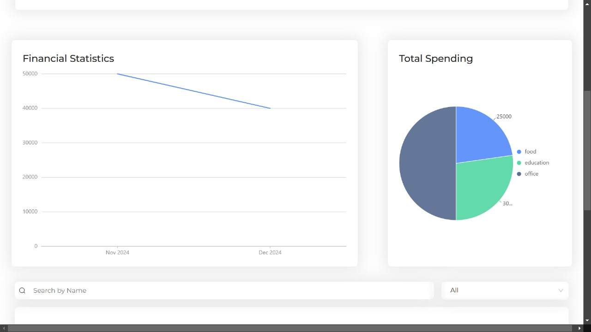
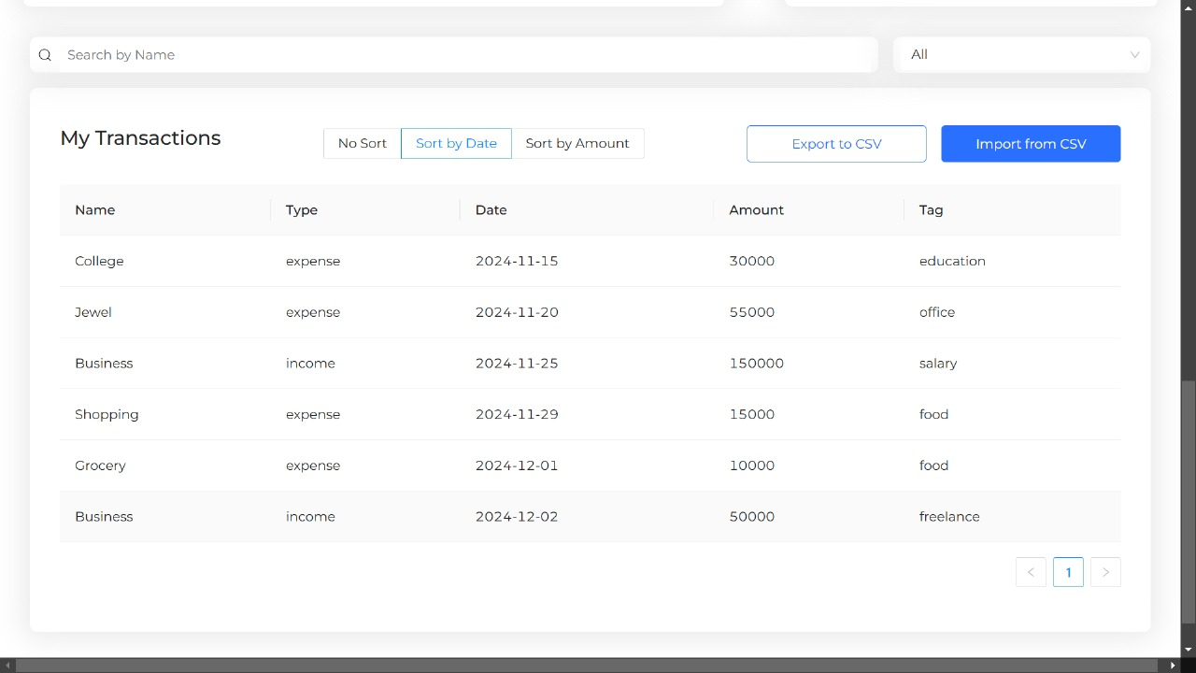
RESULTS AND DISCUSSION

Slide 15
CONCLUSION
In the rapidly evolving world of financial management, advanced systems are poised to revolutionize how individuals and organizations approach their financial goals. These technologies have already showcased their ability to streamline processes such as budgeting, expense tracking, and decision-making, paving the way for further innovation.As these technologies mature, they will bridge the gap between complex financial tasks and user-friendly solutions, creating opportunities for individuals and businesses to navigate their finances with confidence and efficiency.
Key attributes of the system include its scalability, modularity, and user-centric design. The modular codebase, with clear separation of concerns, ensures maintainability and simplifies future feature enhancements. The robust error-handling mechanisms and responsive UI provide a polished experience, catering to users with varying data sizes and interaction patterns. Additionally, the ability to customize currency formatting and support for multilingual representation positions the system as adaptable to diverse use cases.

Slide 16
THANK YOU

